Slide 1










ADVENTURE TIME: ABOVE THE CLOUDS
START

Slide 2
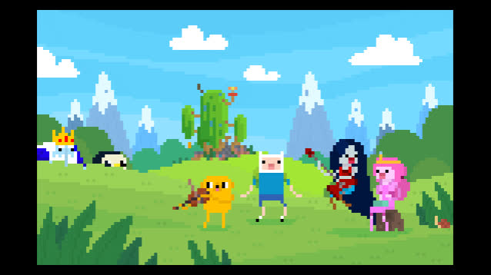

Slide 3
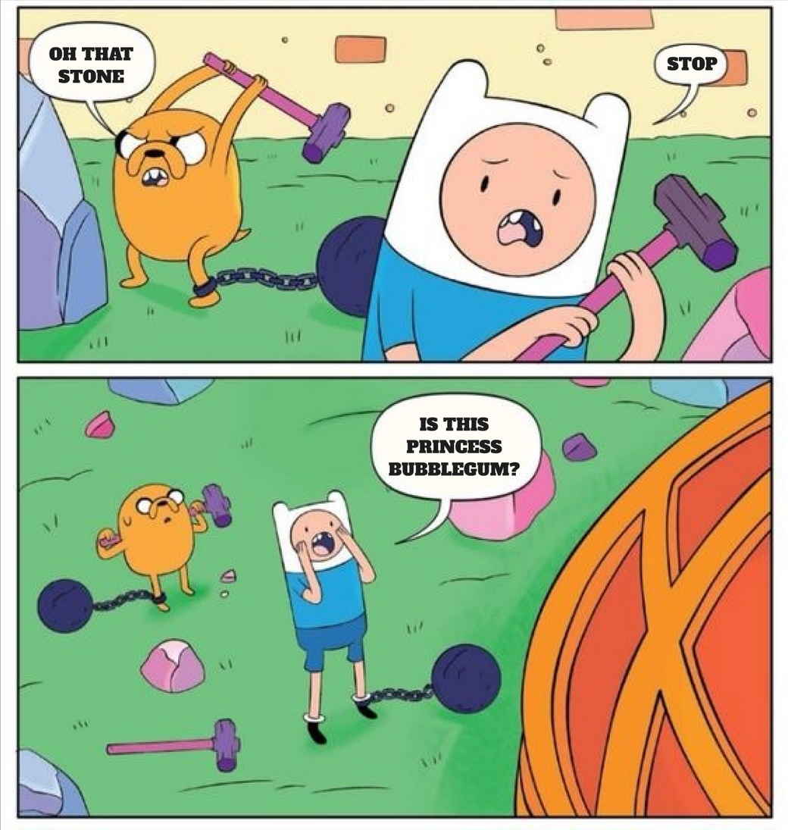
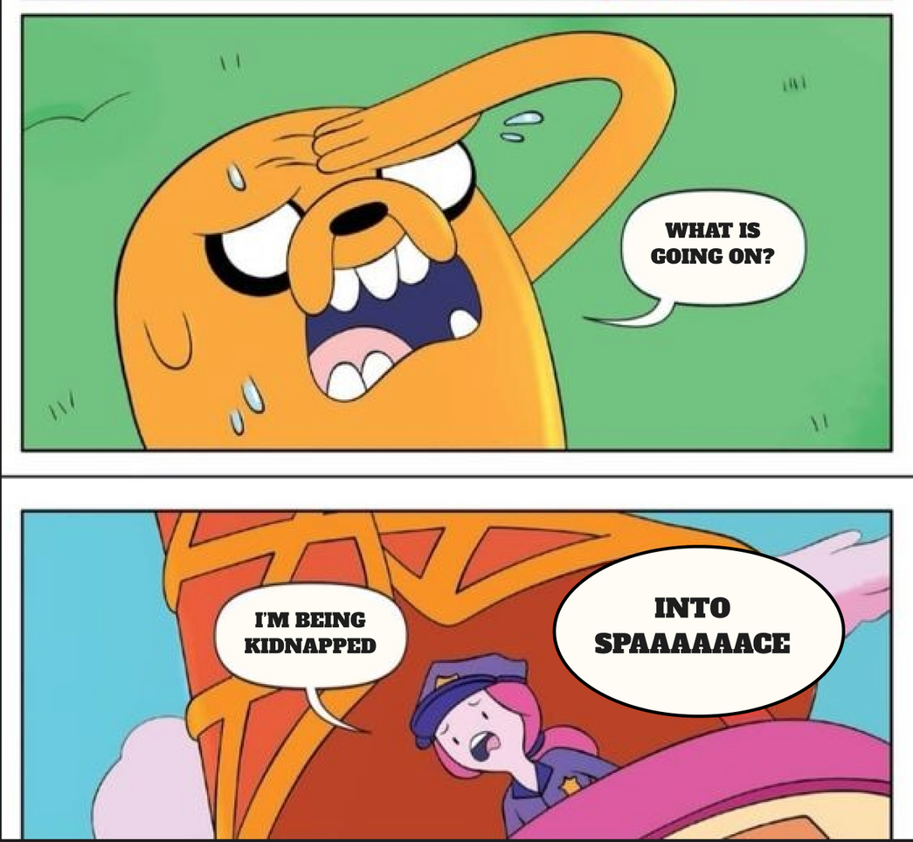
PREHISTORY

Slide 4







How to Play?
01.
02.
03.
You will choose a character to play
Jumping higher you will collect coins
You will use the collected coins to buy characters

Slide 5
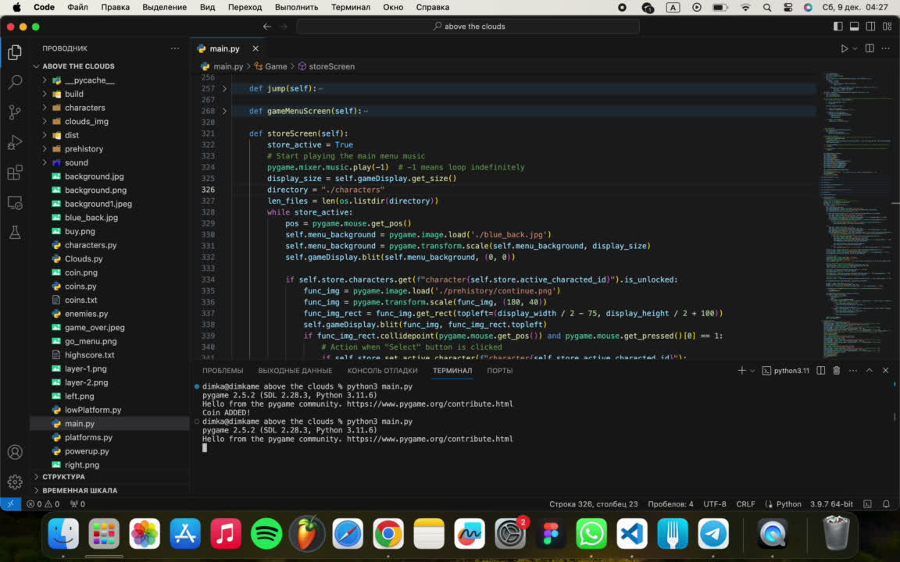

Slide 6






LET US SHOW YOU OUR GAME DEVELOPMENT PROCESS!

Slide 7





STEP 1
Princess Bubblegum, what was our first step?
CHOOSING A TOPIC
ADVANCE TO THE NEXT STEP

Slide 8


Slide 9
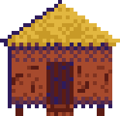

STEP 2
DIVIDING RESPONSIBILITIES
ADVANCE TO THE NEXT STEP

Slide 10
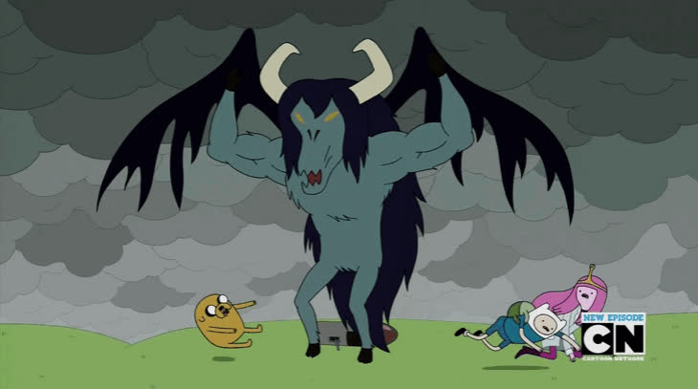

Slide 11


STEP 3
CREATING A PLOT
CHOOSING THE DESIGN

Slide 12


Slide 13
STEP 4
WRITING CODE
IMPLEMENTATION OF DESIGN

Slide 14


Slide 15
STEP 5
TESTING CODE
WORKING ON BUGS

Slide 16



TEAM PROJECT MANAGEMENT
LET’S SEE

Slide 17


Slide 18


Slide 19





MUTUAL RESPECT AND SUPPORT

Slide 20


Slide 21
DEFINING RESPONSIBILITIES

Slide 22


Slide 23
PROBLEM SOLVING

Slide 24
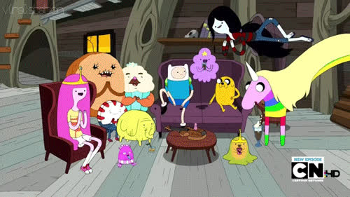

Slide 25
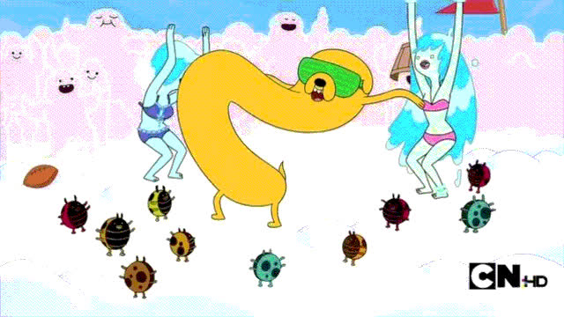

Slide 26
CELEBRATING EVERY SUCCESS

Slide 27

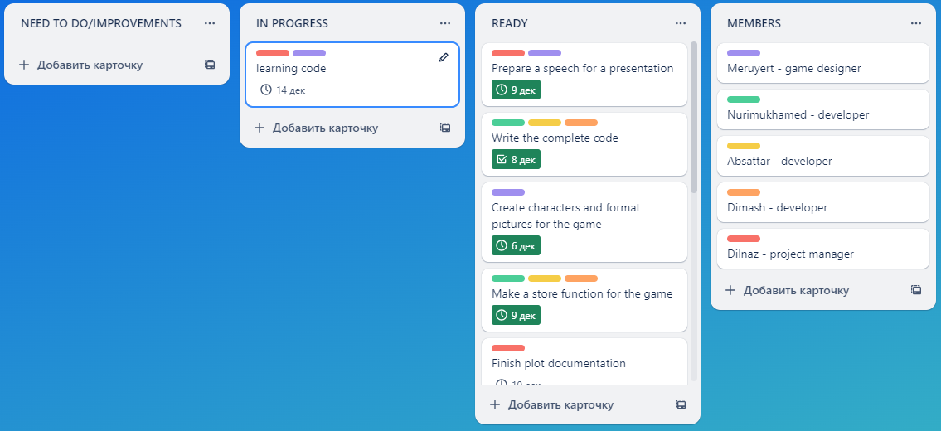
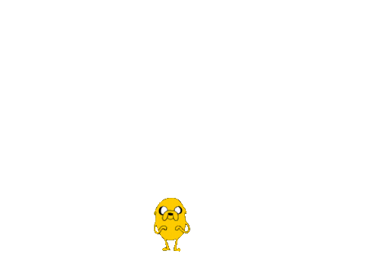
TRELLO DESK
https://trello.com/invite/b/491WWCEh/ATTI0180db64f4cfbf93d18d0fcb6a642abcCE7C711A/d

Slide 28



Developers
Nuridin Absattar
Begali Dinmukhammed
Tazhdinov Nurimukhamed

Slide 29



Game designer
ADAMBAY MERUYERT

Slide 30
Project manager
KOISHYBEKOVA DILNAZ

Slide 31

thank you!

